Slide 2
Notes:
Summarizes the database of the SQL code

Slide 3
Notes:
Same set of structures from other programming languages
Just need to know how the syntax works
Self explanatory
AVG = find the average
MIN and MAX = find the min/max (go thru whole set) of the data
COUNT = how many things are on there

Slide 4

Notes:
When we wrap around the SUM parentheses, it adds it all up as a summation as total_due
The WHERE statement is adding it up for any rows that have total_due > 0
It’s a summary query is not because of SUM
Count = number of invoices that were selected to be added together according to the criteria

Slide 5
Notes:
ROUND = up to 2 decimals, as an input
Instead of a numerical number, use a specific date with the relational operator
Notice that the string is in the selection_date column as the return

Slide 6
Notes:
A and Z apply to min and max

Slide 7

Notes:
You can also do this on strings of characters
Notice the min vendor is the A (alphabet)
And max vendor is Z (last letter)
And count the number of vendors that qualify between it

Slide 8
Notes:
This is useful in cases of repetitive information in some specific column
The DISTINCT means it only lists the distinct vendor_ids (uniqueness)
The second count is the total number of invoices

Slide 9
Notes:
These are the basic ideas of syntax

Slide 10
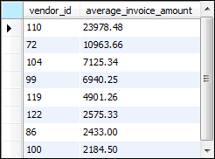
Notes:
SELECT vendor_id, round it off with the average of invoice total with 2 decimals
Group by vendor_id that have the average of an average of > 2000
Notice no amounts are less than 2000
Order by the descending thing of amount (higher → lower)
GROUP BY and HAVING is an additional requirement
Useful to get a certain range (subset of data) with a certain parameter that can be put on top of it

Slide 11
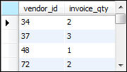
Notes:
Basic GROUP BY
Group by the vendor id and the total quantity
According to W3 schools, it groups rows that have the same values into summary rows
Notice it’s usually used with aggregate statements
How many invoices does something have? (Count everything as it)

Slide 12
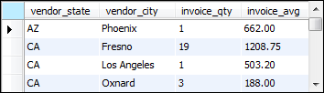
Notes:
Join two types of tables together
On the equal vendor_id
The group by are part of the selection criteria
COUNT * counts the number of invoice_qty
Sequential nature to GROUP BY (think as ORGANIZE BY, alphabetically speaking)

Slide 13
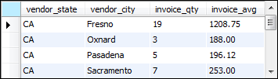
Notes:
Any invoice_qty < 2 not here
The HAVING is the limit but you could replace it as invoice_qty>=2 ???

Slide 14
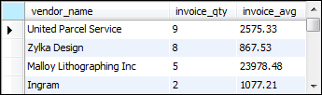
Notes:
GROUP BY vendor_name
Invoice_total is average ofinvoice total (invoice_avg) > 500
Then order it in a descending format
HAVING is like WHERE but with aggregate functions
Aggregate functions = perform a calculation on multiple value

Slide 15

Notes:
WHERE vs HAVING:
- As said, HAVING only as aggregate function

Slide 16
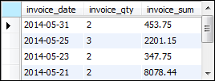
Notes:
Compound condition (to have an additional requirement)

Slide 18
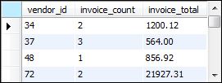

Slide 19
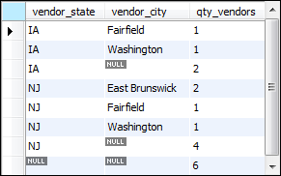
Notes:
WITH ROLLUP
You can see there are params that are null here
Both are ascending

